Slide 1



Benefits of CI/CD

Slide 2


agenda
What Is CI/CD?
Stages of a CI/CD Pipeline
CI/CD Tools
Business Benefits of CI/CD ​
1
Benefits of CI/CD

Slide 3


Continuous Integration and Continuous Delivery/Deployment (CI/CD) is a software engineering practice that automates application build, testing, and deployment. CI/CD practices form the backbone of modern DevOps processes.
This process contrasts with the traditional approach to software development—consolidating multiple small software updates into one large release, thoroughly testing it, and only then deploying it. CI/CD pipelines support the agile concept of development in small iterations, enabling teams to deliver value to customers faster, and create a rapid feedback loop for developers.
What is CI/CD
1
Benefits of CI/CD

Slide 4
Continuous Integration
Continuous Integration (CI) was designed to solve this problem and support agile development processes.
CI means that any changes developers make to their code are immediately integrated into the master branch of the software project.
The CI system automatically runs tests to catch quality issues, and developers get quick feedback and can fix issues immediately.
Developers often commit to the master branch or work on a short-lived feature branch, and a feature is not considered complete until it is integrated with other code changes in the master branch.
1
Benefits of CI/CD

Slide 5
Continuous Delivery
Traditionally, deploying new software versions has been a large, complex and risky task.
Depending on the size of the software it could take hours, days or weeks, requires detailed checklists and many manual steps
The CI system automatically runs tests to catch quality issues, and developers get quick feedback and can fix issues immediately.
Continuous Delivery (CD, also known as CDel) aims to solve these problems through automation.
The CD approach allows teams to package software and deploy it to production environments with the push of a button.
The basic principle of CD is that any change to a software project can be deployed to a production environment immediately, without any special effort.
1
Benefits of CI/CD

Slide 6
Continuous Deployment
Continuous Deployment (CDep) goes one step further than continuous delivery.
All changes going through all stages of the production pipeline undergo automated tests, and if these tests pass, they are immediately deployed to production and exposed to customers.
Continuous deployment can be difficult to implement.
It requires seamless automation at all stages of the process, robust automated testing suites, and a culture of “continuous everything” that enables detection and rapid response to production issues.
1
Benefits of CI/CD

Slide 7

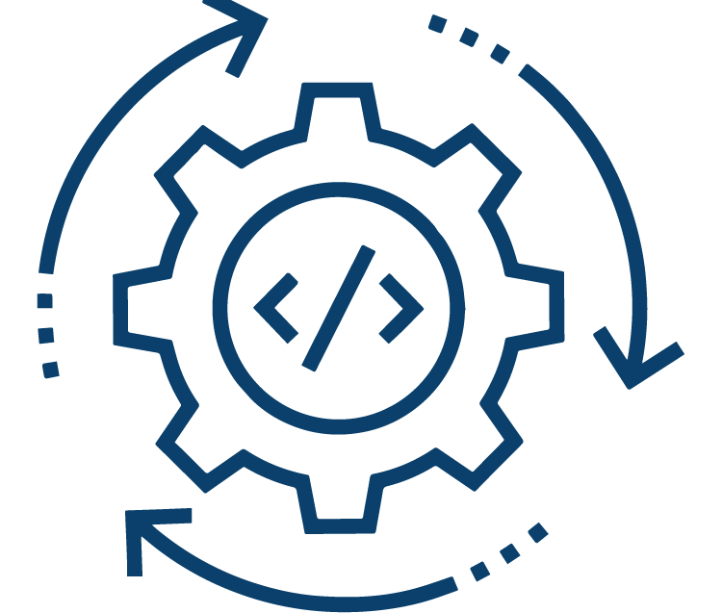

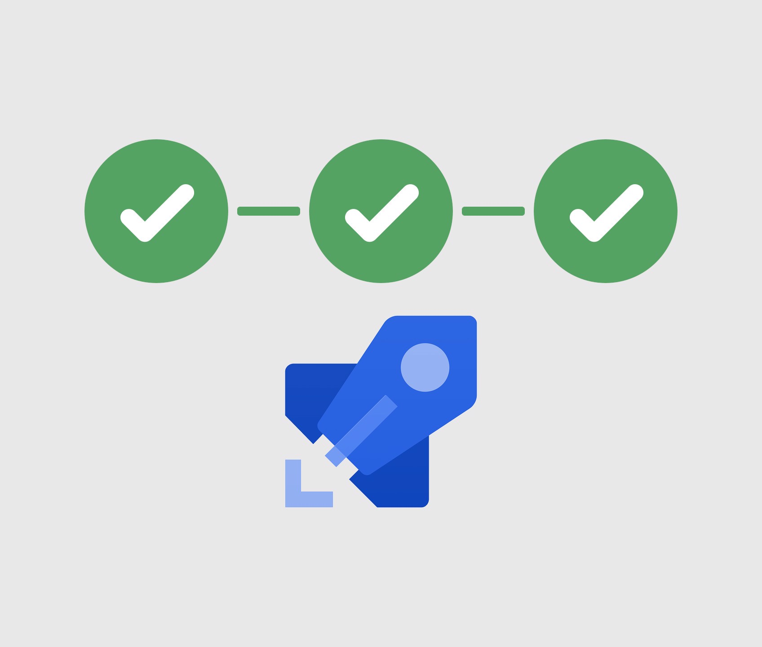
Ci/cd STAGES
The CI/CD pipeline performs continuous integration, delivery, and deployment in four phases:
source
build
test
deploy
Git and SVN or any code commit tools
Build source to executable file
Validate the executable file is running correctly
Deploy the executable file to the server
1
Benefits of CI/CD

Slide 8



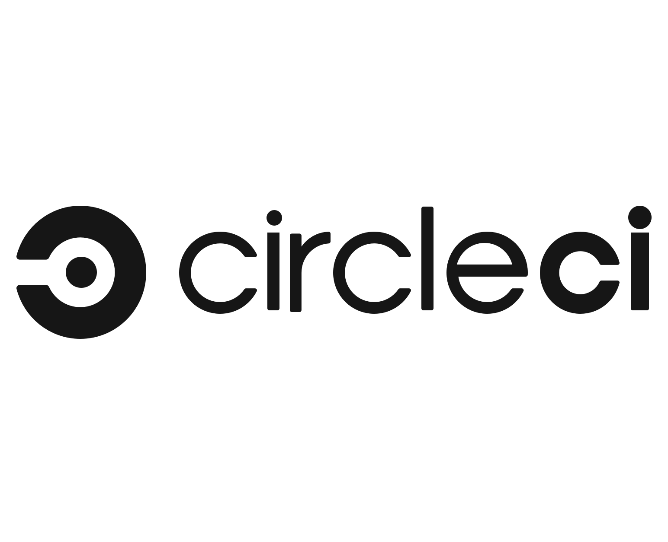




CI/CD Tools
Codefresh
bitbucket
JENKINS
circleci
CI/CD TOOL
CI TOOL
CI TOOL
CI TOOL
AWS Code pipeline
Azure Pipelines
Spinnaker
Go-CD
CD TOOL
CD TOOL
CD TOOL
CD TOOL
1
Benefits of CI/CD

Slide 9
Business Benefits of CI/CD
Bring Products to Market Faster :
CI/CD can bring new products and features to market faster and immediately start generating revenue from the features they deploy rather than waiting for the entire app to be completed (and checked manually) before they can launch .
Respond to consumer needs as they evolve :
Teams have the flexibility to update applications and build and deploy new ones in response to emerging trends, new markets, and evolving expectations.
1
Benefits of CI/CD

Slide 10
Business Benefits of CI/CD
CI/CD supports customer outcomes from a technical standpoint:
When a product goes to market, organizations typically monitor and record user activity and collect feedback from consumers. This allows them to make sure that software bugs and usability issues don’t go undetected and cause lasting damage to the product’s (or the company’s) reputation.
Boosts DevOps efficiency :
CI/CD automation can eliminate manual tasks, prevent coding errors, detect problems before deployment, allowing teams to work faster without compromising quality. Because it takes less time for development teams to find and fix problems during the production process, CI/CD can dramatically accelerate release rates. What’s more, organizations can support recurring releases if code is developed in an automated testing pipeline.
<number>
Benefits of CI/CD

Slide 11
Business Benefits of CI/CD
Reduce Costs and Boost Profits :
CI/CD is also good for the bottom line. It standardizes deployment processes across all projects, and, done right, it enables teams to systematically test every change made to the source code.
As a result, this process stands to dramatically reduce the likelihood that any bugs or errors slip through the cracks and cause problems down the line. Done right, this practice can lower development costs by eliminating many of the costs incurred while building and testing code changes.
Teams spend less time on testing and bug fixes, meaning organizations spend less money on tasks that don’t provide any value to the business or its customers.
<number>
Benefits of CI/CD

Slide 12

Thanks
<number>
Benefits of CI/CD

